Slide 1
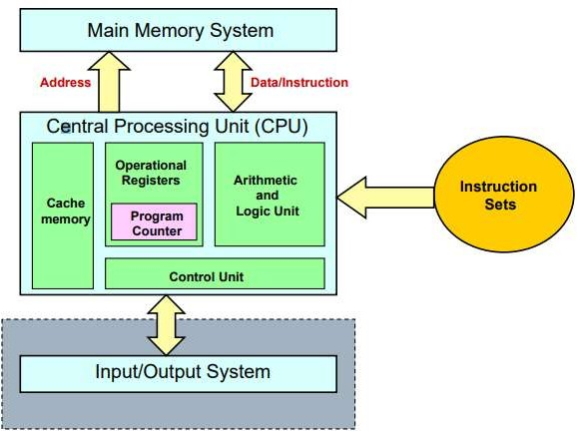
Unit: 4
Input-Output Organization Lecture-1
Peripheral Devices
The I/O subsystem of a computer provides an efficient mode of communication between the central system and the outside environment. It handles all the input output operations of the computer system.
Peripheral Devices:
Input or output devices that are connected to computer are
called peripheral devices. These devices are designed to read information into or out of the memory unit upon command from the CPU and are considered to
be the part of computer system. These devices are also called peripherals.
For example: Keyboards, display units and printers are common peripheral devices.
There are three types of peripherals:
Input peripherals: Allows user input from the outside world to the computer e.g. Keyboard, Mouse etc.
Output peripherals: Allows information output, from the computer to the outside world. e.g. Printer, Monitor etc.
Input-Output peripherals: Allows both input (from outside world to computer) as well as, output (from computer to the outside world0 e.g. touch screen etc.

Slide 2
